Slide 1



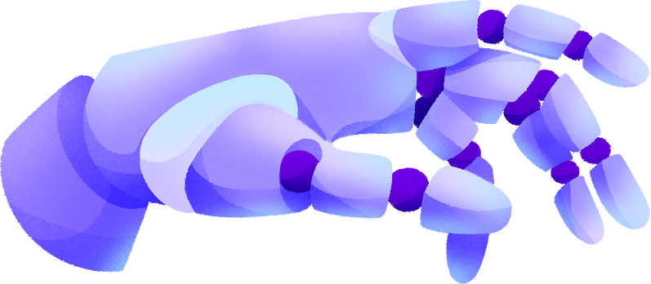


CS F407
ARTIFICIAL INTELLIGENCE
PROJECT
Improved Network Routing via Hybrid Metaheuristics

Slide 2

MEET THE TEAM GROUP 49
NAME
ID NO.
Varad Gorantyal
Atharva Chikhale
Suyash Patil
2021A4PS1995H
2021A7PS2752H
2021A7PS2078H

Slide 3



INTRODUCTION TO NETWORK ROUTING
Network routing is the process of selecting the best path for data to travel from one network location to another.
Efficient network routing is crucial for ensuring fast and reliable data transfer.
Metaheuristic search algorithms such as genetic algorithm, dijkstra algorithm, simulated annealing, and floyd warshall algorithm can be used for network routing optimization.

Slide 4


ALGORITHMS IMPLEMENTED
01
02
03
04
05
Dijkstra’s Algorithm
Floyd Warshall
Algorithm
A Star
Algorithm
Simulated Annealing
Genetic
Algorithm

Slide 5




GENETIC ALGORITHM
A metaheuristic search algorithm inspired by the process of natural selection.
Uses a population of candidate solutions and applies genetic operators such as crossover and mutation to generate new solutions.
Fitness function evaluates the quality of each solution and selects the fittest individuals for the next generation.
Can be used for network routing to find the shortest path or optimal route between nodes.

Slide 6




SOURCE
C
10
A
8
7
2
E
1
3
2
DESTINATION
3
D
B

Slide 7
SOURCE
C
10
A
8
7
2
E
1
3
2
DESTINATION
3
D
B
Total Cost = 8
Path: A->B->D->E

Slide 8
SOURCE
C
10
A
8
7
2
E
1
3
2
DESTINATION
3
D
B
Total Cost = 14
Path: A->B->D->C->E

Slide 9
SOURCE
C
10
A
8
7
2
E
1
3
2
DESTINATION
3
D
B
Total Cost = 8
Path: A->B->C->D->E

Slide 10
SOURCE
C
10
A
8
7
2
E
1
3
2
DESTINATION
3
D
B
Total Cost = 10
Path: A->D->E

Slide 11
SOURCE
C
10
A
8
7
2
E
1
3
2
DESTINATION
3
D
B
Total Cost = 13
Path: A->C->D->E

Slide 12
SOURCE
C
10
A
8
7
2
E
1
3
2
DESTINATION
3
D
B
Total Cost = 17
Path: A->C->E

Slide 13
WORKING OF GA
Step 1: Initializing Population
Taking a randomly generated string which starts which source tower and ends with destination towers with different sizes.
Example:
A->B->D->E
A->C->E
A->B->C->D->E

Slide 14
WORKING OF GA
Step 2: Evaluation Function
Considering two adjacent characters of the individual of population as two towers and adding the distances between them.
Example:
A->B->D->E : A->B + B->D + D->E
3 + 3 + 2
Total cost = 8

Slide 15
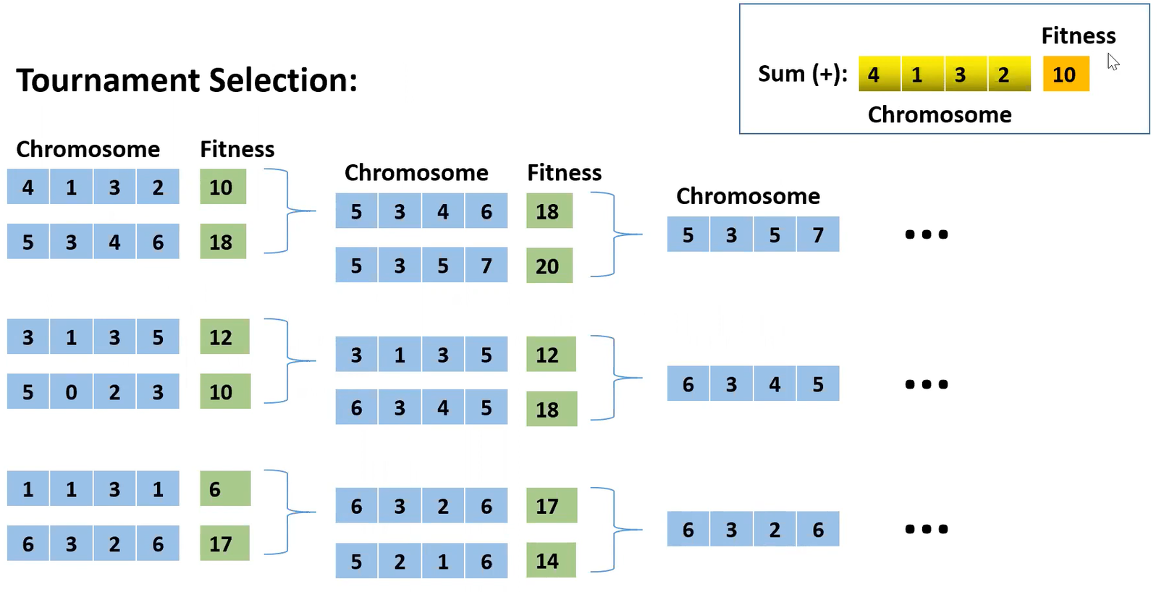
WORKING OF GA
Step 3: Selection
Calculating the average cost of total population and selecting individuals greater than the average cost.

Slide 16
WORKING OF GA
Step 4: Crossover
In this step we take the path from two parents to create new individuals (offspring). This mimics the process of genetic recombination.
Example:
A->B->C->D->E
A->C->D->E
The offsprings generated are:
A->B->D->E
A->C->C->D->E

Slide 17
WORKING OF GA
Step 5: Mutation
Apply small random changes to some individuals in the population. Mutation introduces genetic diversity and prevents the algorithm from getting stuck in local optima.
Example: Single Bit Mutation
A->B->D->E
A->C->D->E

Slide 18
WORKING OF GA
The process then repeats from step 2 for a predefined number of generations or until a termination criterion is met. Over successive generations, the population tends to evolve towards better solutions as individuals with higher fitness are more likely to be selected as parents and pass their genetic material to the next generation.

Slide 19

THANK YOU!

